Slide 1


SAVITRIBAI PHULE PUNE UNIVERSITY
A PRELIMINARY PROJECT REPORT ON
“Waste Mitra: AI-Powered Smart Waste Management System for Sustainable Disposal”
submitted to words the
partial fulfillment of the requirements of
BACHELOR OF ENGINEERING (Computer Engineering)
BY
Yash bhalerao Lokesh bhosle Yash Sonawane Mauli wanave
Exam No:B400510367 Exam No:B400510307 Exam No:B400510366 Exam No:B400510365
UNDER THE GUIDANCE OF
Dr. Vinod Wadne
DEPARTMENT OF COMPUTER ENGINEERING JSPM’s IMPERIAL COLLEGE OF ENGINEERING AND RESEARCH, WAGHOLI, PUNE 412 207 2025-26

Slide 2

JSPM’s
IMPERIAL COLLEGE OF ENGINEERING AND RESEARCH, WAGHOLI, PUNE 412 207
DEPARTMENT OF COMPUTER ENGINEERING
C E R T I F I C A T E
This is to certify that the seminar work entitled Waste Mitra: AI-Powered Smart Waste Management System for Sustainable Disposal
Submitted by
YASH BHALERAO LOKESH BHOSLE YASH SONAWANE MAULI WANAVE
Exam No:B400510367 Exam No:B400510307 Exam No:B400510366 Exam No:B400510365
is a bonafide work carried out under the supervision of Dr. Vinod Wadne and it is submitted towards the partial fulfillment of the requirement of Bachelor of Engineering(Computer Engineering).
Dr. Vinod Wadne (H.O.D)
(Project Guide) Computer EngineeringDepartment
Dr. Vinod Wadne (H.O.D)
Computer Engineering Department
DR. R. S. Deshpande (PRINCIPAL)
EXTERNAL EXAMINER
Date: Place:

Slide 3
Abstract
India faces a growing challenge in managing the vast amount of waste generated every day. The absence of automated waste identification and state-specific disposal guidelines often results in improper segregation and environmental degradation. This report presents Waste Mitra, an AI-driven smart waste management system designed to classify different types of waste through image-based analysis and provide appropriate disposal instructions tailored to each Indian state. The system utilizes advanced computer vision and cloud-based APIs for waste recognition and integrates real-time regulatory information to promote safe and sustainable waste handling.
Developed using Django, the platform offers instant analysis, detailed guidance, and a user-friendly web interface accessible to the general public. It employs a hybrid architecture, combining image preprocessing with AI/LLM classification (Gemini LLM), resulting in superior performance compared to baseline models. The system's primary goal is to bridge the gap between technology and environmental awareness, contributing to cleaner communities and efficient waste practices.
Keywords: AI-Based Waste Recognition, Waste Management, Computer Vision, Sustainable Development, Machine Learning, Deep Learning.

Slide 4
Acknowledgement
It gives us great pleasure in presenting the preliminary project report on “Waste Mitra: AI-Powered Smart
Waste Management System for Sustainable Disposal ”and to express our deep regards towards those who have offered their valuable time and guidance in our hour of need.
We would like to take this opportunity to thank our internal guide Dr. Vinod Wadne for giving us all the help
and guidance we needed. We are really grateful for her kind support. Her valuable suggestions were very helpful.
We are also grateful to Dr. Vinod Wadne, Head of Computer Engineering Department, ICOER for his indis- pensable support, suggestions.
We are also glad to express our gratitude and thanks to our Principal Dr. R. S. Deshpande for his constant inspiration and encouragement.
Finally, we would like to express once again our gratitude and thanks to all those who are involved directly and indirectly in achieving our project a success.
Yash bhalerao Lokesh bhosle Yash Sonawane Mauli wanave
(B.E. Computer Engg.)

Slide 5
Contents
Abstract |  | i
Acknowledgement |  | ii
1 SYNOPSIS |  | 1
1.1 Project Title ................................................................................................................................................ 1
1.2 Project Guide . . . . . . . . . . . . . . . . . . . . . . . . . . . . . . . . . . . . . . . . . . . . . . . | .1
1.3 Technical Keywords (As per ACM Keywords) . . . . . . . . . . . . . . . . . . . . . . . . . . . . . . | .1
1.4 Problem Statement . . . . . . . . . . . . . . . . . . . . . . . . . . . . . . . . . . . . . . . . . . . . | .1
1.5 Abstract . . . . . . . . . . . . . . . . . . . . . . . . . . . . . . . . . . . . . . . . . . . . . . . . . . Goals and | .1
1.6 Objectives . . . . . . . . . . . . . . . . . . . . . . . . . . . . . . . . . . . . . . . . . . . Relevant mathematics | .1
1.7 associated with the Project . . . . . . . . . . . . . . . . . . . . . . . . . . . . Names of Conferences / | .2
1.8 Journals where papers can be published . . . . . . . . . . . . . . . . . . . . Review of | .2
1.9 Conference/Journal Papers supporting Project idea . . . . . . . . . . . . . . . . . . . . . . | .2
1.10 Plan of Project Execution:- . . . . . . . . . . . . . . . . . . . . . . . . . . . . . . . . . . . . . . . . | .5
2 TECHNICALKEYWORDS |  | 6
2.1 Area of project . . . . . . . . . . . . . . . . . . . . . . . . . . . . . . . . . . . . . . . . . . . . . . | .6
2.2 Technical Keywords (As per ACM Keywords) . . . . . . . . . . . . . . . . . . . . . . . . . . . . . . | .6
3 INTRODUCTION |  | 7
3.1 3.2 PMrojteicvtaItidoena................................................ | .7
LiteratureSurvey............................................ | .8
3.3 . | .8
PROBLEMDEFINITION AND SCOPE
  4.1P.r1ob4l.e1m.2 S4t.2ate4m.3eMnta.jo. r. .C.o.n.s.tr.a.in. t.s. .. .. .. .. .. .. .. .. .. .. .. .. .. .. .. .. .. .. .. .. .. .. .. .. . . . . . . . . . . . . . . . . . . . .
. 4.4 MeGthoadlos laongdieosbojfecPtrivoebsle.m. .so. l.v.in. g. .a.n.d. e.f.fi.c.ie.n.c.y. i.s.su. e. s. . . . . . .. .. ............... . . . . . . . . . .
Statement of scope . . . . . . . . . . . . . . . . . . . . . . . . . . . . . . . . . . . . . . . .
Software Context . . . . . . . . . . . . . . . . . . . . . . . . . . . . . . . . . . . . . . . . . . . . .
10
.10
.10
.10
.10
.10
.10
.11
.11
.11
.11
.11
  Scenario in which multi-core, Embedded and Distributed Computing used . . . . . . . . . . . . . . .
  Outcome . . . . . . . . . . . . . . . . . . . . . . . . . . . . . . . . . . . . . . . . . . . . . . . . . .
  Applications . . . . . . . . . . . . . . . . . . . . . . . . . . . . . . . . . . . . . . . . . . . . . . . .
  Hardware Resources Required . . . . . . . . . . . . . . . . . . . . . . . . . . . . . . . . . . . . . .
  Software Resources Required . . . . . . . . . . . . . . . . . . . . . . . . . . . . . . . . . . . . . . .
Project Plan
  5.1P.r1oj5e.c1t.2Es5t.i2mRatiessk .M. .an. a. g. e. m. .e.n.t .w. i.th. .re. s. p. e.c.t.t.o.N. .P. H. .ar. d. .c.an. a. l.y.s.is. . . . . . . . . . . . . . . . . .
. . . . . . .R. e.conciled Estimates . . . . . . . . . . . . . . . . . . . . . . . . . . . . . . . . . . . . . . .
Project Resources . . . . . . . . . . . . . . . . . . . . . . . . . . . . . . . . . . . . . . . . .
12
.12
.12
.12
.13
.13
.14
.14
.16
    Risk Identification . . . . . . . . . . . . . . . . . . . . . . . . . . . . . . . . . . . . . . . .
    Risk Analysis . . . . . . . . . . . . . . . . . . . . . . . . . . . . . . . . . . . . . . . . . . .
    Overview of Risk Mitigation, Monitoring, Management . . . . . . . . . . . . . . . . . . . .
5.3 Project Schedule . . . . . . . . . . . . . . . . . . . . . . . . . . . . . . . . . . . . . . . . . . . . .

Slide 6
Acknowledgement ii .......................................................................................................................................... 3 1
SYNOPSIS 1 ............................................................................................................................................. 3 5.3.1
Project task set ........................................................................................................................................ 21 5.3.2
Task Network .......................................................................................................................................... 22 5.3.3
Timeline Chart ........................................................................................................................................ 22 Team
Organization ............................................................................................................................................... 23
5.4
Software Requirement Specification.........................................................................................................................24
6
6.1 Introduction ......................................................................................................................................................... 24
6.1.1
6.1.2
Purpose and Scope of Document ............................................................................................................ 24
Overview of responsibilities of Developer .............................................................................................. 24
6.2
Usage Scenario .................................................................................................................................................... 24
6.2.1
6.2.2
User profiles ............................................................................................................................................ 25
Use Case Diagram ................................................................................................................................... 26
6.3
Data Model and Description ................................................................................................................................ 26
6.3.1
Data Description ..................................................................................................................................... 26
Data objects and Relationships ............................................................................................................... 26
6.3.2
6.4
Functional Model and Description ...................................................................................................................... 26
6.4.1
6.4.2
6.4.3
6.4.4
6.4.5
Data Flow Diagram ................................................................................................................................. 27
Data Flow Diagram ................................................................................................................................. 27
Non Functional Requirements: ............................................................................................................... 28
State Diagram: ........................................................................................................................................ 28
Design Constraints .................................................................................................................................. 28
Software Interface Description ............................................................................................................... 28
6.4.6
Detailed Design Document.........................................................................................................................................29
7
  Introduction ......................................................................................................................................................... 29
  Architectural Design ............................................................................................................................................ 29
  Data design .......................................................................................................................................................... 30
7.3.1
7.3.2
7.3.3
Internal software data structure ............................................................................................................... 30
Global data structure ............................................................................................................................... 30
Database description ............................................................................................................................... 30
7.4
Component Design .............................................................................................................................................. 30
7.4.1
Class Diagram ......................................................................................................................................... 30
7.5
Project Implementation ........................................................................................................................................ 31
7.5.1
Tools and Technologies Used.................................................................................................................. 31
7.6
Software Testing .................................................................................................................................................. 33
8
Technical Specification ............................................................................................................................................... 34
  Advantages and Disadvantages ........................................................................................................................... 35
  Disadvantages ...................................................................................................................................................... 35
  Applications ......................................................................................................................................................... 35
9
Conclusion ................................................................................................................................................................... 36
9.1 Future Scope ........................................................................................................................................................ 36
References.................................................................................................................................................................... 37
RESULT ............................................................................................................................ Error! Bookmark not defined.

Slide 7
List of Figures
1.1 Execution Plan . . . . . . . . . . . . . . . . . . . . . . . . . . . . . . . . . . . . . . . . . . . . . . .5 5.1 Task Network . . . . . . . . . . . . . .
. . . . . . . . . . . . . . . . . . . . . . . . . . . . . . . . . .17 6.1 Use Case . . . . . . . . . . . . . . . . . . . . . . . . . . . . . . . . . . . . . . . . . . . . .
. . . . .21 6.2 DataFlow Diagram . . . . . . . . . . . . . . . . . . . . . . . . . . . . . . . . . . . . . . . . . . . . .22 6.3 DataFlow Diagram .
. . . . . . . . . . . . . . . . . . . . . . . . . . . . . . . . . . . . . . . . . . . .22 6.4 Activity Diagram 1 . . . . . . . . . . . . . . . . . . . . . . . . . . .
. . . . . . . . . . . . . . . . . .23 6.5 Activity Diagram 2 . . . . . . . . . . . . . . . . . . . . . . . . . . . . . . . . . . . . . . . . . . . . .24 6.6
Activity Diagram . . . . . . . . . . . . . . . . . . . . . . . . . . . . . . . . . . . . . . . . . . . . . .25 7.1 Architecture . . . . . . . . . . . . . . . .
. . . . . . . . . . . . . . . . . . . . . . . . . . . . . . . . .27 7.2 Class Diagram . . . . . . . . . . . . . . . . . . . . . . . . . . . . . . . . . . . . . . . . . .
. . . . . .28 7.3 Output 1 . . . . . . . . . . . . . . . . . . . . . . . . . . . . . . . . . . . . . . . . . . . . . . . . . . .31 11.1 Output A . . . . . . . . .
. . . . . . . . . . . . . . . . . . . . . . . . . . . . . . . . . . . . . . . . .38 11.2 Output B . . . . . . . . . . . . . . . . . . . . . . . . . . . . . . . . . . . . .
. . . . . . . . . . . . . .39 11.3 Output 1 . . . . . . . . . . . . . . . . . . . . . . . . . . . . . . . . . . . . . . . . . . . . . . . . . . .40 11.4 Output 2
. . . . . . . . . . . . . . . . . . . . . . . . . . . . . . . . . . . . . . . . . . . . . . . . . . .41 11.5 Output 3 . . . . . . . . . . . . . . . . . . . . . . . . . . . .
. . . . . . . . . . . . . . . . . . . . . . .42 11.6 Output 4 . . . . . . . . . . . . . . . . . . . . . . . . . . . . . . . . . . . . . . . . . . . . . . . . . . .43
11.7 Output 5 . . . . . . . . . . . . . . . . . . . . . . . . . . . . . . . . . . . . . . . . . . . . . . . . . . .44 11.8 Output 6 . . . . . . . . . . . . . . . .
. . . . . . . . . . . . . . . . . . . . . . . . . . . . . . . . . . .45 11.9 Output 7 . . . . . . . . . . . . . . . . . . . . . . . . . . . . . . . . . . . . . . . . . . . .
. . . . . . .46
  Output 8 ...................................................................................................................................................... 47
  Output 9 ...................................................................................................................................................... 48
  Output 10 .................................................................................................................................................... 49
  Output 11 .................................................................................................................................................... 50

Slide 8
List of Tables
5.1 Risk Table ................................................................................................................................................................... 14

Slide 9
Waste Mitra: AI-Powered Smart Waste Management System for Sustainable Disposal
1 SYNOPSIS
  Project Title
Waste Mitra: AI-Powered Smart Waste Management System for Sustainable Disposal
  Project Guide
Dr. Vinod Wadne
  Technical Keywords (As per ACM Keywords)
    AI-Based Waste Recognition
    Computer Vision Sustainable Development
    Deep Learning
    Django Framework Gemini LLM
  Problem Statement
The absence of automated waste identification and readily available state-specific disposal guidelines often results in improper waste segregation, leading to environmental degradation and pollution. The core problem is the inefficiency of manual classification and the lack of awareness about legal and eco-friendly disposalmethods.
  Abstract
The abstract is provided in Page 3.
  Goals and Objectives
Goals
To provide an intelligent, automated solution for waste classification and disposal guidance. To encourage smart and sustainable waste management practices.
To enable citizens to contribute directly to sustainability goals.
Objectives
To develop an AI-powered system for waste category detection. To provide legal and eco-friendly disposal guidance to users.
To reduce manual effort and improve waste segregation accuracy. To create a user-friendly web interface using Django.

Slide 10
Waste Mitra: AI-Powered Smart Waste Management System for Sustainable Disposal
1.7 Relevant mathematics associated with the Project
The project involves image classification and performance testing where core metrics are measured. Classification Accuracy: Computed as Total PredictionsCorrect Predictions×100.
Average Response Latency: Calculated as Number of TestsΣ(Response Time). The AI-powered model targets higher classification accuracy and faster response times compared to a baseline model.
1.8
Names of Conferences / Journals where papers can be published
IEEE/ACM Conference/Journal
Central Universities or SPPU Conferences
International Journal of Advanced Research in Computer and Communication Engineering (IJARCCE) International Journal of Computer Science and Information Technologies (IJCSIT)
1.9 Review of Conference/Journal Papers supporting Project idea
Title
Waste Classification Using Convolutional Neural Networks
AI-based E-Waste Identification and Management
System
A Legal-Aware Smart Waste Disposal Framework
Location-Based
Waste Management Assistant using Deep Learning and GIS
Waste Disposal Law Compliance System Using NLP
Author Name
A. Kumar, S. Mehta
R. Sen, M. Chatterjee
K. Patil, T. Shah, J. D'Souza
P. Rao, L. Menon, S. Jadhav
S. Kaur, B. Reddy
Description
Explores using CNN models for classifying waste images into categories like plastic, metal, and paper, noting the importance of preprocessing.
The system detects e-waste using machine learning and guides users on proper disposal, emphasizing accuracy and compliance with waste regulations.
Proposes a system that integrates regional legal data into waste disposal guidance, using APIs to map waste categories to local municipal rules.
Detects waste type through deep learning and recommends disposal methods based on the user's GPS location, combining GIS mapping with classification.
Focuses on extracting waste disposal laws using NLP from government portals and mapping the extracted legal text with waste categories.

Slide 11
Waste Mitra: AI-Powered Smart Waste Management System for Sustainable Disposal
1.10 Plan of Project Execution:-
The project execution follows a standard phased approach:
Initiation Phase: Project Definition: Project constraints and problem statements are defined. The goal is to classify waste and provide regional legal disposal guidance.
Planning Phase: Detailed Planning: Estimation & Scheduling is conducted. This involves selecting Python, Django, and Gemini LLM as core technologies and designing the modular architecture.
Execution Phase: Project Team: Acquisition, Development & Management. This phase involves implementing the frontend (Django Templates, pure CSS), backend logic, and integrating the AI model for classification and the LLM for legal rule generation.
Project Closure: Monitoring, Controlling, Closure & Review. System testing is performed, where the AI model performance is verified (e.g., 93.2% accuracy). Final documentation is prepared.

Slide 12
Waste Mitra: AI-Powered Smart Waste Management System for Sustainable Disposal
2 TECHNICAL KEYWORDS
  Area of project
The area of the project is Smart Environmental Systems and AI-Driven Waste Management. The implementation is based on Web Application Development and Computer Engineering.
  Technical Keywords (As per ACM Keywords)
Prediction/Recognition Machine Learning Deep Learning
Python
Django Framework Gemini LLM

Slide 13
Waste Mitra: AI-Powered Smart Waste Management System for Sustainable Disposal
3 INTRODUCTION
  Project Idea
The core idea is Waste Mitra, an AI-powered web application that automates waste recognition and provides users with precise disposal guidance based on regional environmental policies. Users upload a waste image, which is analyzed by the AI Classification Engine (Gemini LLM) to classify the type (organic, recyclable, electronic, or hazardous). The system then links this classification to state-specific regulations to recommend proper disposal or recycling methods. The front-end uses Django Templates and pure CSS to offer a user-friendly, responsive interface.
  Motivation
The motivation stems from the environmental intensification caused by improper waste disposal and resource mismanagement in the digital age.
Inefficient Traditional Systems: Traditional segregation systems rely heavily on manual, slow, and error-prone classification.
Lack of Compliance: Improper handling of materials due to lack of awareness causes soil and water contamination.
Technological Solution: The adoption of AI and automation presents a promising solution for precision, consistency, and adaptability in waste management.
Empowering Citizens: The system decentralizes awareness and responsibility, empowering every citizen to contribute directly to sustainability goals
  Literature Survey
Category
Classification
Monitoring
Framework/Appro ach
Adaptability
Technology/Focus
AI (Convolutional Neural Networks - CNNs)
IoT (Ultrasonic Sensors & GPS)
SERC Framework
Compliance and Localization
Key Findings/Context
CNNs have been successfully used for waste classification.
Focused on monitoring bin fill levels and improving waste
Proposed linking: Image input (I) $\to$ Detected categories
(D) $\to$Regulatory
rules (R), mapped to
Interpretability and localized adaptability are crucial for deployment.
Unaddressed Gaps/Future Direction
Efficiency for lightweight web applications requires optimization, guiding the need for
Material classification was not solved by these monitoring studies.
N/A (This is a proposed solution/framewor k).
The proposed approach must merge computer vision, cloud

Slide 14
Waste Mitra: AI-Powered Smart Waste Management System for Sustainable Disposal
Title
Waste Classification Using Convolutional Neural Networks 104
A Legal-Aware Smart Waste Disposal Framework 106
Location-Based Waste Management Assistant 108
Description
Used CNN but needed high computational resources105.
Integrates regional legal data into disposal guidance107.
Combines deep learning with GIS based on user's GPS location109.

Slide 15
Waste Mitra: AI-Powered Smart Waste Management System for Sustainable Disposal
4 PROBLEM DEFINITION AND SCOPE
  Problem Statement
To provide an accurate, automated solution for waste classification and legal disposal guidance, addressing the core issue of improper waste segregation and environmental compliance due to manual methods and lack of clear, state- specific guidelines
    Goals and objectives Goals
•
•
•
To drastically reduce the incidence of improper waste segregation. To provide Real Time Access to disposal guidelines.
To provide Security for user data and system integrity.
•
•
•
Objectives
To increase the efficiency of waste prediction.
To decrease the time required for prediction and viewing results. To make the system more secure.
To enable the system to autonomously identify the waste category and fetch disposal guidelines from the database
4.1.2 Statement of scope
The system is scoped to build an AI-driven platform for waste recognition and compliance management. It includes: AI classification via image upload, storage of analysis history, role-based access for User and Admin, and dynamic generation of state-specific disposal rules. It does not currently include physical hardware (IoT) or municipal collection logistics.
  Software Context
Operating System: Windows / Linux
Platform/IDE: Pycharm, Anaconda- Jupyter Notebook ML Tools: TensorFlow / PyTorch for image classification
  Major Constraints
Model Scalability: The system may experience slower response times and require significant computational resources as user numbers increase.
Dataset Diversity: Image recognition performance can degrade under different lighting, camera qualities, or background clutter.
API Dependency: Reliance on third-party APIs for AI classification and guideline retrieval introduces vulnerability to downtime or policy change.
  Methodologies of Problem solving and efficiency issues
The system uses a divide and conquer approach by modularizing the architecture (client–server model). This supports distributed or multi-core environments for efficiency. The methodology ensures quick processing by autonomously identifying waste and fetching rules without manual external verification.

Slide 16
Waste Mitra: AI-Powered Smart Waste Management System for Sustainable Disposal
  Scenario in which multi-core, Embedded and Distributed Computing used
The AI classification and real-time guideline fetching benefit from Distributed Computing and Multi-core Processing. The cloud-based API architecture (Gemini Pro) is inherently a distributed computing solution, enabling the massive computational load of image analysis to be handled efficiently for real-time results
  Outcome
Provides Accuracy (e.g., 93.2%) and produces effective results. Provides real-time, state-specific disposal instructions.
Reduces reliance on slow, error-prone manual classification.
  Applications
Real time usage to achieve prediction in waste disposal. Enables users to contribute directly to sustainability goals.
Supports intelligent waste management solutions for smart cities.
  Hardware Resources Required
    Hardware
      RAM : 8GB for faster processing
      CPU : 3GHz for sufficient processing power
  Software Resources Required
Frontend: HTML, CSS, JavaScript, Bootstrap Backend: Python, Django Framework
LLM: Gemini / OpenAI model (for legal disposal guidance) Database: MySQL / PostgreSQL (for waste rules and category data) OS Compatibility: Windows / Linux

Slide 17
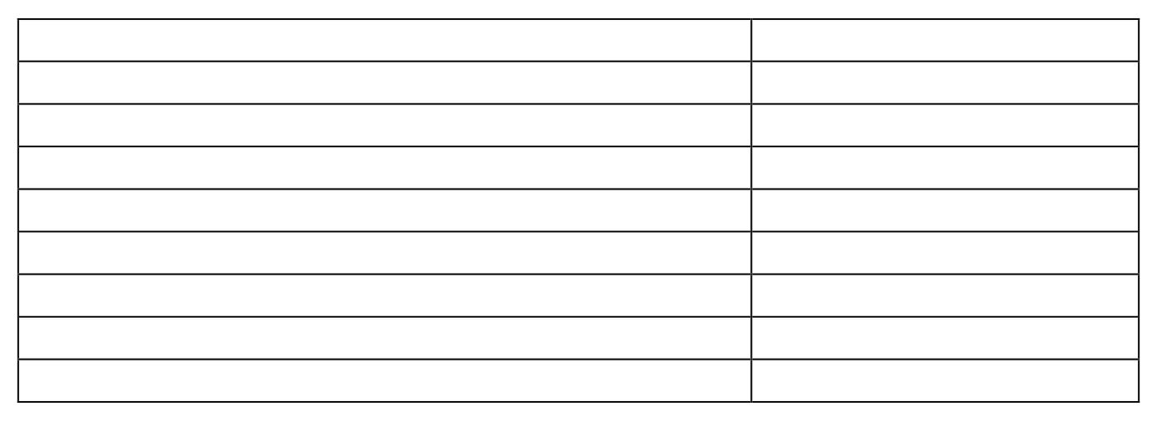
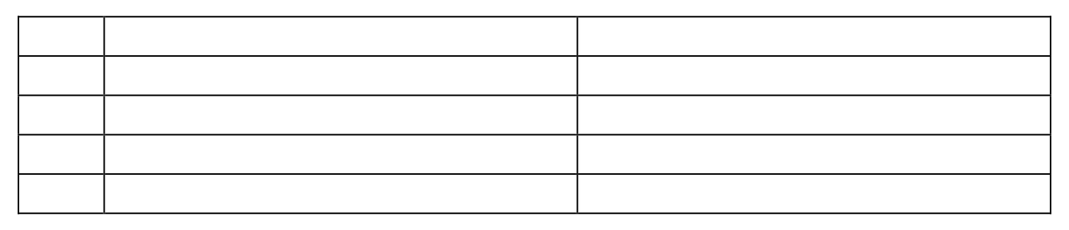
Waste Mitra: AI-Powered Smart Waste Management System for Sustainable Disposal
5 Project Plan
5.1 Project Estimates
5.1.1
Reconciled Estimates
Cost estimates 1.IDE - Free 2. Hardware and software cost
Time Estimates
Procedure | Time | 15
Literature Research | days | 30
System Analysis | days | 30
Design and Planning and Database | days | 30
Learning Required Technologies | days | 31
Implementation | days | 27
System Testing | days | 15
Initial Report | days | 16
Final Report | days
5.1.2 Project Resources
ID Name of Person 1 2 Dr. Vinod Wadne
3 4 Yash Lokesh Mauli
Responsibility Project Guide Developer Developer Developer
Hardware
  RAM : 8GB for faster processing
  CPU : 3GHz for sufficient processing power
Software
  Platform: Pycharm, Anaconda, Jupiter Notebook
  Operating System: Windows (Ubuntu 14.04)
  Programming Language: Python
  Framework: Flask, Django, etc.

Slide 18
Waste Mitra: AI-Powered Smart Waste Management System for Sustainable Disposal
5.2 Risk Management with respect to NP Hard analysis
Risk ID
1
2
3
Risk Description
Unauthorized API access
Model Scalability
End User's Satisfaction
Probability
Medium Medium High
Impact
Medium 159
High 160
High 161
5.2.1 Risk Identification
Risk ID
1
2
3
Risk Description
Unauthorized API access
Model Scalability
End User's Satisfaction
Strategy
Secure APIs
maintain privacy during cloud transmission162.
Use hybrid
configuration; future use of lightweight neural architectures and federated
Continuous user feedback, transparency in data use164.

Slide 19
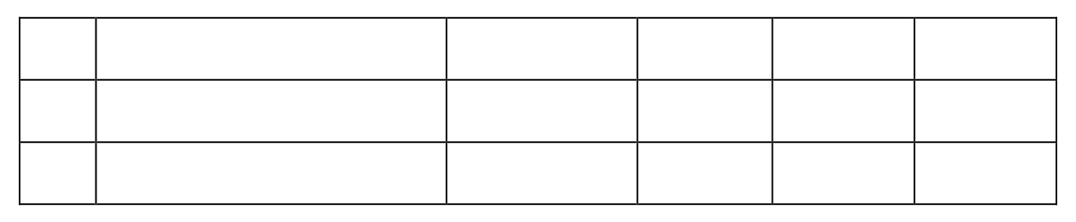
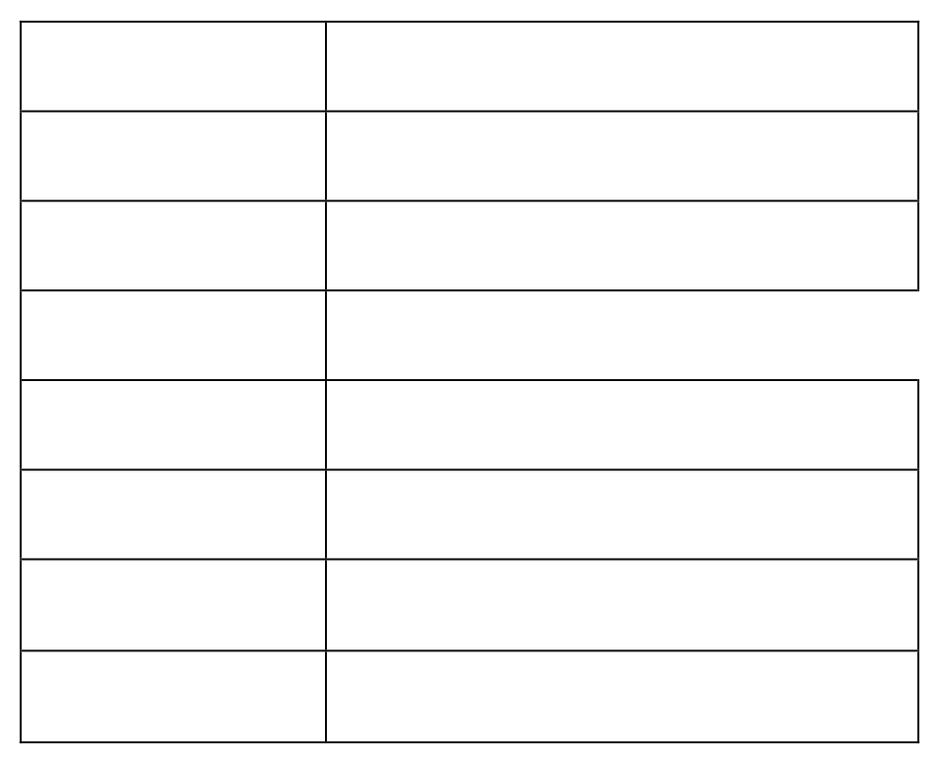
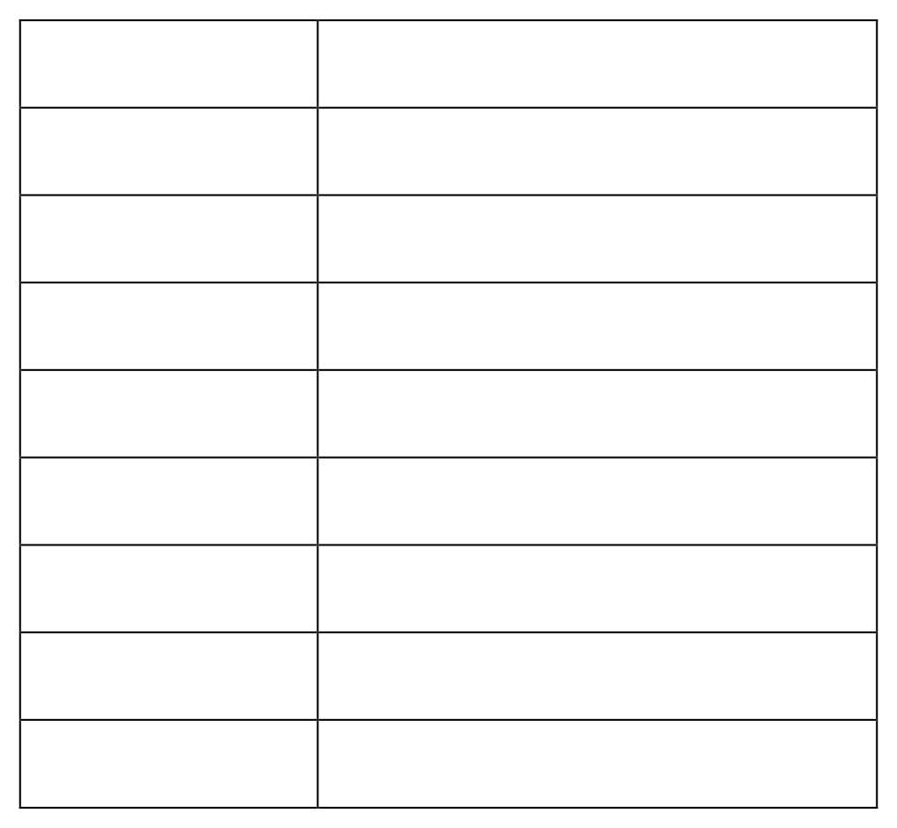
Waste Mitra: AI-Powered Smart Waste Management System for Sustainable Disposal
5.2.2 Risk Analysis
The risks for the Project can be analyzed within the constraints of time and quality
ID Risk Description
Usage of Product
Financial Requirement
Probability Low Med
Impact Low Med
Quality High High
Overall High High
Table 5.1: Risk Table
5.2.3 Overview of Risk Mitigation, Monitoring, Management
Risk ID
1
Risk Description
unauthorized API access
Category
End User’s Environment
Probability
Medium
Impact
Medium
Response
Mitigate
Risk Status
Identified
Risk ID
2
Risk Description
Model Scalability
Category
Development Environment
Source
Prediction of disease
Probability
Medium
Impact
High
Response
Serious
Strategy
API are used
Risk Status
Identified

Slide 20
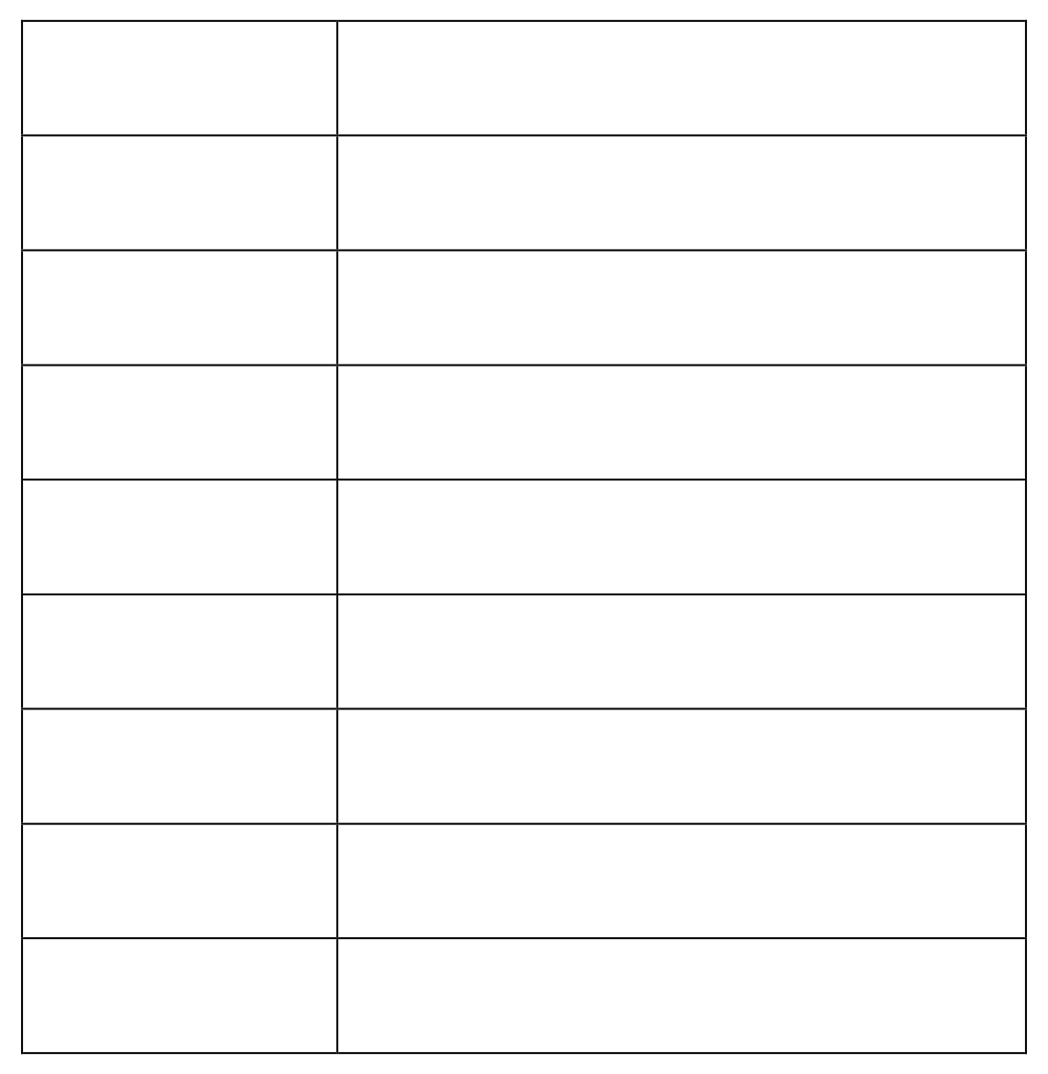
Waste Mitra: AI-Powered Smart Waste Management System for Sustainable Disposal
Risk ID
6
Risk Description
User Base not using the product
Category
User Base
Source
Software Design Specification.
Probability
Low
Impact
High
Response
Adding new features consistently
Strategy
Advertising in the Newspapers, Journals
Risk Status
May Occur
5.3 Project Schedule
5.3.1
Project task set
Task 1: Literature Research Task 2: System Analysis
Task 3: Design & Planning and Data-set Task 4: Learning Required Technologies
Task 5: Implementation (Frontend, Backend, AI) Task 6: System Testing
Task 7: Initial Report Task 8: Final Report
21

Slide 21
Waste Mitra: AI-Powered Smart Waste Management System for Sustainable Disposal
6 Software Requirement Specification
  Introduction
    Purpose and Scope of Document
Purpose: The main objective is to automate waste classification and provide accurate, region-specific disposal guidance. The project aims to optimize the performance of AI algorithms for real-world waste recognition. Scope: Machine Learning techniques are used to predict waste type and provide guidance, improving care and reducing environmental costs. The core scope is the AI-powered web platform for waste recognition.
  Usage Scenario
The primary function is the image upload and analysis loop for the end-user.
Image Upload: The user uploads an image of the waste item through an intuitive interface.
Automated Processing: The system autonomously identifies the waste category (e.g., plastic, glass, organic) and fetches disposal guidelines.
Results Display: The interface displays the detected category and appropriate disposal/recycling recommendations.
    User profiles
User (General Public): Initiates the waste recognition process. Can upload images, view results, access waste history, and gain educational insights.
Admin (Administrator): Responsible for managing the database of waste categories and updating state-specific disposal regulations
24

Slide 22
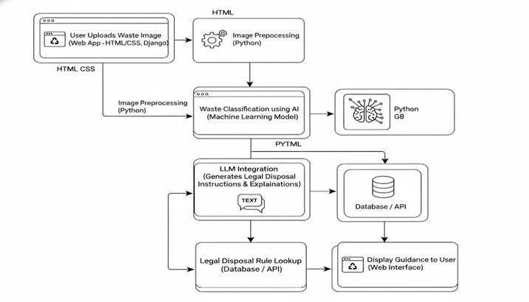
Waste Mitra: AI-Powered Smart Waste Management System for Sustainable Disposal
6.2.2 Use Case Diagram
Figure 6.1: Use Case
  Data Model and Description
    Data Description
Data objects that will be managed/manipulated by the software are described in this section. The database entities or files or data structures required to be described. For data objects details can be given as below
      Queries
      Processing
      Processed
      Result
    Data objects and Relationships
Data objects and their major attributes and relationships among data objects are described using an ERD- like form.
6.4 Functional Model and Description
A description of each major software function, along with data flow (structured analysis) or class hierarchy (Analysis Class diagram with class description for object oriented system) is presented.

Slide 23
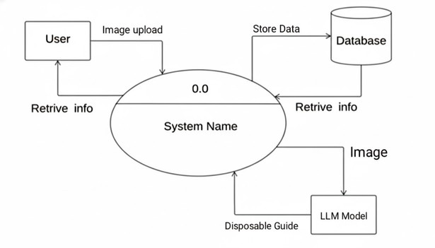
Waste Mitra: AI-Powered Smart Waste Management System for Sustainable Disposal
    Data Flow Diagram
      Data Flow Diagram
Figure 6.2: Dataflow Diagram

Slide 24
Waste Mitra: AI-Powered Smart Waste Management System for Sustainable Disposal
    Non Functional Requirements:
      InterfaceRequirements: The interface should be easy to use and intuitive.
      PerformanceRequirements: The system should give an effective and high performance.
      Softwarequalityattributes: Availability, Reliability, Re-usability, Scalability, Performance, Usability
The system considers following non-functional requirements to provide better functionalities and usage of system.
Usability: The system is designed keeping in mind the usability issues considering the end-users who are developers/programmers. Effort required in learning, operating, preparing input, and interpreting output are to be minimized. It provides detailed help which would lead to better and faster learning. Navigation of system is easy.
Agility: Improves with users able to rapidly and inexpensively re-provision technological infrastructure resources. The cost of overall computing is unchanged, however, and the providers will merely absorb up-front costs and spread costs over a longer period.
Consistency: Uniformity in layout, screens, colors scheme, via dynamic (”on-demand”) provisioning of re- sources on a fine-grained, self service basis near real-time, without users having to engineer for peak loads.
Performance: Performance depends on the user’s familiarity with the usage of the system.
Extendibility: Templates can be imported from different applications, adding more features in workflow.
Reusability: The native files provided in the system can be used any number of times for faster execution. New native files can be created and saved which again can be made available. Since the application is network host based, it can be used anywhere anytime by a single user.
Reliability: Protection of data from malicious attack and unauthorized access. Improves through the use of multiple redundant sites, which makes mobile agents suitable for business continuity and disaster recovery
    State Diagram:
State Transition Diagram:
The states are represented in ovals and state of system gets changed when certain events occur. The transitions from one state to the other are represented by arrows. The Figure shows important states and events that occur while creating new project.
    Design Constraints
Any design constraints that will impact the subsystem are noted. There is a necessity to study design patterns in detail. Depending upon the various kinds of patterns available, different design constraints may be encountered such as supporting multiple operating systems which may not be possible due to using the .NET framework. The schedule is tight and deadlines prove a reasonable constraint while adding features.
    Software Interface Description
The interface must be easy to understand and use. It must be intuitive and explain the use at a glance. The software also needs to interface with existing search engines. This will be handled using an API or a web scraper.

Slide 25
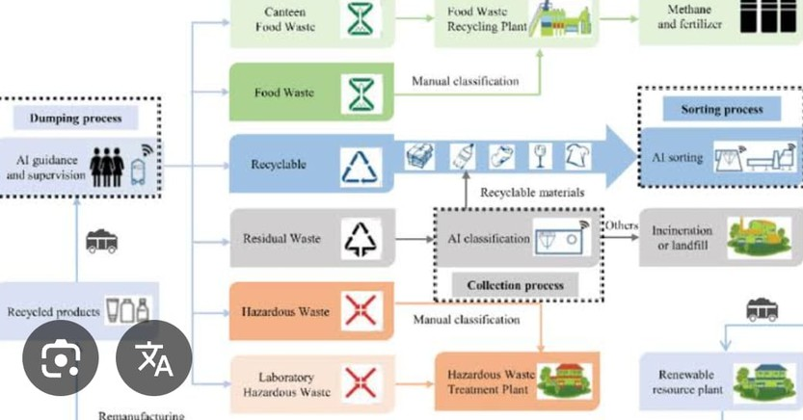
Waste Mitra: AI-Powered Smart Waste Management System for Sustainable Disposal
7 Detailed Design Document
  Introduction
This section details the architectural and component design of Waste Mitra, emphasizing its modular structure for security, scalability, and transparency
  Architectural Design
A description of the program architecture is presented.
Figure 7.1: Architecture

Slide 26
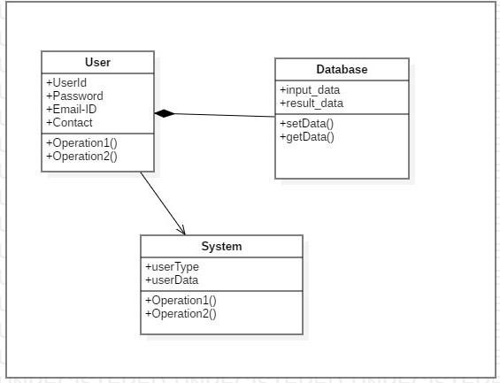
Waste Mitra: AI-Powered Smart Waste Management System for Sustainable Disposal
  Data design
A description of all data structures including internal, global, and , database design (tables), file formats.
    Internal software data structure
      Machine Learning based
    Global data structure
Data structured that are available to major portions of the architecture are described.
      Machine Learning based
    Database description
The database will be used to store data for future prediction.
  Component Design
7.4.1
Class Diagram
Class diagrams are the most common diagrams used in UML. Class diagram is main building block of any object oriented solution. It shows the classes in system, attributes and operations of each class and the relationship between each class. Class diagrams are static in nature.
Figure 7.2: Class Diagram

Slide 27
Waste Mitra: AI-Powered Smart Waste Management System for Sustainable Disposal
7.5 Project Implementation
7.5.1
Tools and Technologies Used
Frontend: HTML, CSS, JavaScript, Bootstrap Backend: Python, Django Framework LLM/AI Model: Gemini / OpenAI model
ML Model: Image Classification (TensorFlow / PyTorch)
IDE / Tools: VS Code, Jupyter Notebook, GitHub [Page 28]
Django Framework: Used for the backend, providing structure, security (CSRF protection), and template rendering.
Gemini LLM: Used for waste classification and, crucially, for generating the contextual and legal disposal instructions and explanations.
Image Preprocessing: Python libraries handle image resizing, noise reduction, and background removal for uniform input quality before AI model execution.

Slide 28
Waste Mitra: AI-Powered Smart Waste Management System for Sustainable Disposal
7.6 Software Testing
Test Case
TC-001 TC-003 TC-006
Test case Objective
Leave all fields as blank and click
Log-in button
Enter valid Username
Enter Correct password
Expected Result
Mandatory symbol (*) should appear225.
It should allow the user to proceed226.
It should allow the user to proceed227.
GUI Usability Test Scenarios
TC-001
TC-003
Check for Validation Messages
Check text for errors
Validation error
messages Shall be displayed properly228.
All Spelling Shall be Correct229.

Slide 29
Waste Mitra: AI-Powered Smart Waste Management System for Sustainable Disposal
Performance Testing Test Scenarios
TC-003
Check response time for any action
Page shall be loaded within
acceptable time
Database Testing Test Scenarios
TC-001
TC-003
Check if correct data is getting
saved
Check for data integrity
Correct data shall be saved in database231.
Data shall be
stored in single or multiple tables
based on

Slide 30
Waste Mitra: AI-Powered Smart Waste Management System for Sustainable Disposal
8 Technical Specification
8.1 Advantages and Disadvantages
Advantages
High Accuracy/Low Latency: Achieved 93.2% accuracy and 0.8s latency with the AI-powered model. State-Specific Compliance: Provides appropriate disposal instructions tailored to each Indian state.
User-Friendly: Offers a web interface accessible to the general public with a responsive design. Automation: Reduces manual waste segregation effort.
8.2 Disadvantages
API Dependency: The system relies on third-party APIs for classification and guideline retrieval. Scalability Costs: Increased users may require significant computational resources for real-time processing.
Continuous Maintenance: Requires continuous retraining of models and updating of regulatory data by the Admin
8.3 Applications
Household Segregation: Provides guidance to the general public.
Smart Cities: Establishes a practical, scalable, and intelligent model for waste recognition and disposal management for nationwide programs.
Environmental Accountability: Merges cloud intelligence with adaptive learning to improve environmental accountability.

Slide 31
Waste Mitra: AI-Powered Smart Waste Management System for Sustainable Disposal
Conclusion
The Waste Mitra system successfully demonstrates the potential of AI-driven automation in modern waste management. It combines image recognition, data-driven categorization, and real-time disposal guidance to promote responsible environmental practices. By leveraging Gemini LLM for recognition and compliance logic, the system ensures transparency, accuracy, and environmental compliance without the need for external verification. Built using Django and an optimized workflow, the system bridges the gap between technology and sustainability.
  Future Scope
Mobile App and Edge Computing: Focusing on enhancing scalability, perhaps using lightweight neural architectures for edge device compatibility and offline functioning.
Integrate Intelligent Feedback: Implementing mechanisms to achieve more transparent and adaptive waste management solutions.
Smart City Integration: Further integration with smart city infrastructure for large-scale deployments.

Slide 32
Waste Mitra: AI-Powered Smart Waste Management System for Sustainable Disposal
10 References
Waste Mitra: AI-Powered Smart Waste Management System for Sustainable Disposal.
Yash Bhalerao, Yash Sonwane, Mauli Wanave, Lokesh Bhosale, Vinod Wadne. "Waste Mitra: AI- Powered Smart Waste Management System for Sustainable Disposal." [AI based Waste Management.docx].
Smart Waste Category Detector with Legal Disposal Guide. [Smart Waste 1.pptx].
S. Patel, R. Deshmukh, and M. Kadam, “AI-Based Waste Classification Using Deep Learning for Sustainable Smart Cities,” 2024 IEEE International Conference on Green Computing and Sustainable Systems (ICGCSS).
T. Banerjee, V. Rao, and L. Sharma, “Smart Waste Segregation and Recycling System Using Machine Vision,” 2024 5th International Conference on Computational Intelligence and Communication Networks (CICN).
A. Ghosh and R. Nayak, “Sustainable Waste Management Using IoT and AI Integration,” 2024 International Conference on Emerging Technologies in Environmental Systems (ICETES).
J. Mehta, K. Shetty, and A. Patwardhan, "Implementation of Waste Recognition and Segregation Using Cloud-Based APIs,” 2024 IEEE International Conference on Computational Intelligence and Sustainable Technologies(CIST).
H. Zhou, W. Li, and C. Tang, “Computer Vision Applications for Solid and Organic Waste Detection,” IEEE Access, Vol. 12, pp. 56147–56158, 2024.
R. Kumar, S. Yadav, and A. Chakraborty, “Deep Neural Architectures for Automated Plastic Waste Classification,” International Journal of Advanced Computer Science and Applications (IJACSA), Vol. 15, No. 4, 2024.
S. Raj, M. Das, and B. Tripathi, “Hybrid Cloud Architecture for Real-Time Waste Monitoring Systems,” 2024 IEEE Symposium on Smart Urban Systems (SUS).
S. Kaur, B. Reddy, “Waste Disposal Law Compliance System Using NLP.”
K. Patil, T. Shah, J. D'Souza, “A Legal-Aware Smart Waste Disposal Framework.”
M. Thomas, K. Reddy, and P. Gupta, “A Review on Artificial Intelligence for Smart Waste Sorting Systems,” Sustainable Computing: Informatics and Systems, Vol. 39, 2024.
P. Rao, L. Menon, S. Jadhav, “Location-Based Waste Management Assistant using Deep Learning and GIS.”

Slide 33
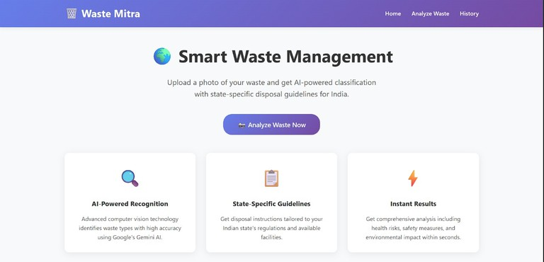
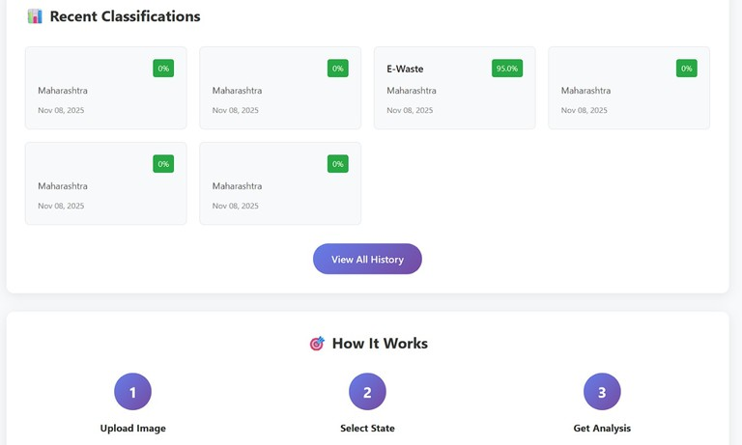
Waste Mitra: AI-Powered Smart Waste Management System for Sustainable Disposal
11. Result
Figure 11.1: Output A
Figure: Output B
40

Slide 34
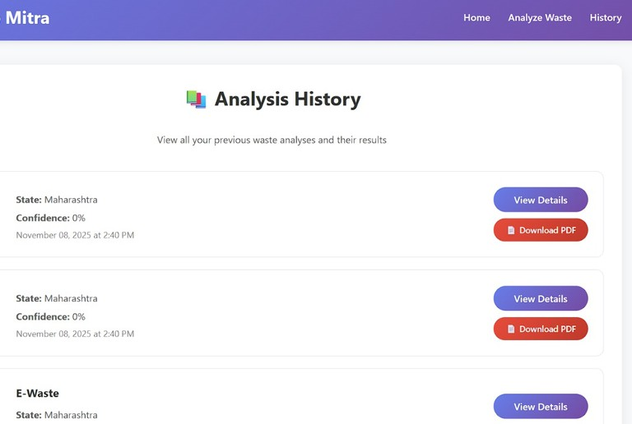
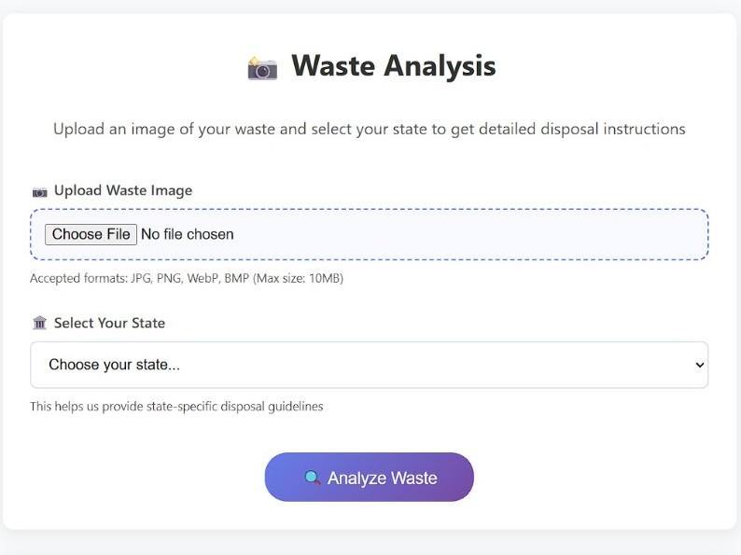
Waste Mitra: AI-Powered Smart Waste Management System for Sustainable Disposal
Figure: Output C
Figure: Output D
42

